Slide 1
Programming II
(C Programming Language)
Memory Allocation in C
Lecture 23, Monday May 03, 2021
Dr. Ayman ALJARBOUH

Slide 2
Outline
Allocating Memory Dynamically in C
C calloc() Function
C malloc() Function
C realloc() Function

Slide 3
Allocating Memory Dynamically in C
As you know, an array is a collection of a number of values. Once the size of an array is declared, you cannot change it
Sometimes the size of the array you declared may be insufficient
To solve this issue, you can allocate memory manually during run-time. This is known as dynamic memory allocation in C programming
The C programming language provides several functions for memory allocation and management, such as malloc(), calloc(), free() and realloc()
These functions can be found in the <stdlib.h> header file

Slide 4

Allocating Memory Dynamically in C
Dynamically allocated memory created by memory allocation functions doesn't get freed on its own
You must explicitly use free() to release the space
The Syntax of free() is:
This statement frees the space allocated in the memory pointed by ptr

Slide 5
Outline
Allocating Memory Dynamically in C
C calloc() Function
C malloc() Function
C realloc() Function

Slide 6
C malloc() Function
The name "malloc" stands for memory allocation
The malloc() function allocates an entire block of memory of the specified number of bytes, without initialize it
The Syntax of malloc() function is:
For example,
An entire block of 400 bytes is allocated to ptr

Slide 7
C malloc() Function
The name "malloc" stands for memory allocation
The malloc() function allocates an entire block of memory of the specified number of bytes, without initialize it
The Syntax of malloc() function is:
For example,
The pointer ptr holds the address of the first byte in the allocated memory. The expression results in a NULL pointer if the memory cannot be allocated

Slide 8
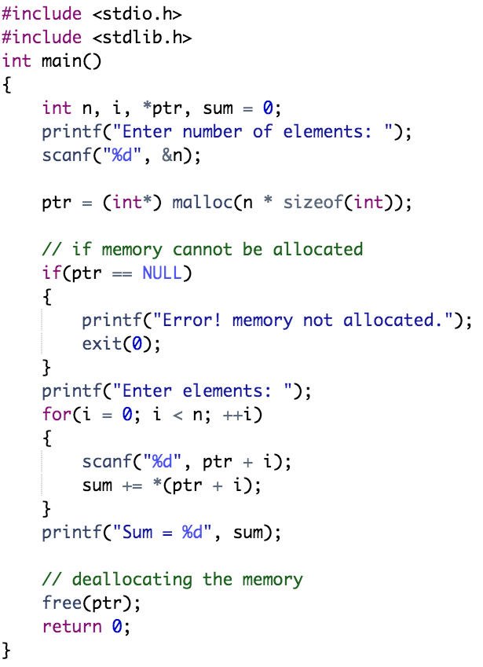
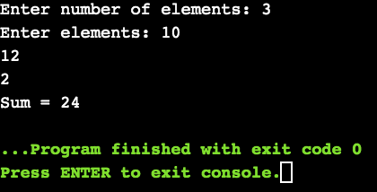
Example: Use of malloc() and free()
Here, we have dynamically allocated the memory for n number of int data type

Slide 9
Outline
Allocating Memory Dynamically in C
C calloc() Function
C malloc() Function
C realloc() Function

Slide 10
C calloc() Function
The name "calloc" stands for contiguous allocation
The malloc() function allocates memory and leaves the memory uninitialized. Whereas, the calloc() function allocates memory and initializes all bits to zero
The Syntax of calloc() is:
For example,
A total of 20 bytes (5 blocks of 4 bytes each) is allocated to ptr

Slide 11
C calloc() Function
The name "calloc" stands for contiguous allocation
The malloc() function allocates memory and leaves the memory uninitialized. Whereas, the calloc() function allocates memory and initializes all bits to zero
The Syntax of calloc() is:
For example,
The above statement allocates contiguous space in memory for 5 elements of type float

Slide 12
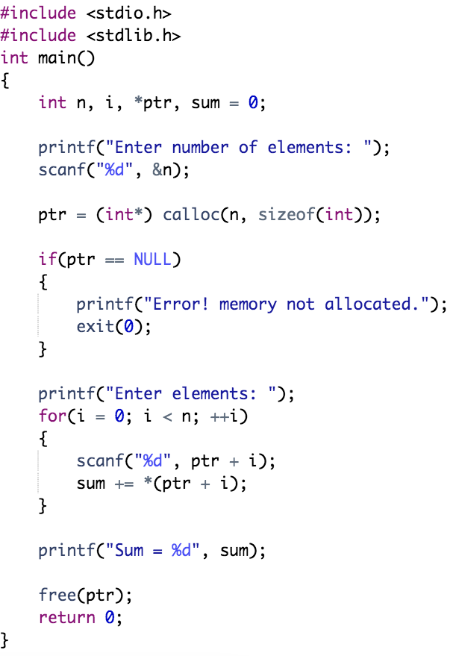
Example: Use of calloc() and free()

Slide 13
Outline
Allocating Memory Dynamically in C
C calloc() Function
C malloc() Function
C realloc() Function

Slide 14

C realloc() Function
If the dynamically allocated memory is insufficient or more than required, you can change the size of previously allocated memory using the realloc() function
The Syntax of realloc() is:
Here, ptr is reallocated with a new size x

Slide 15
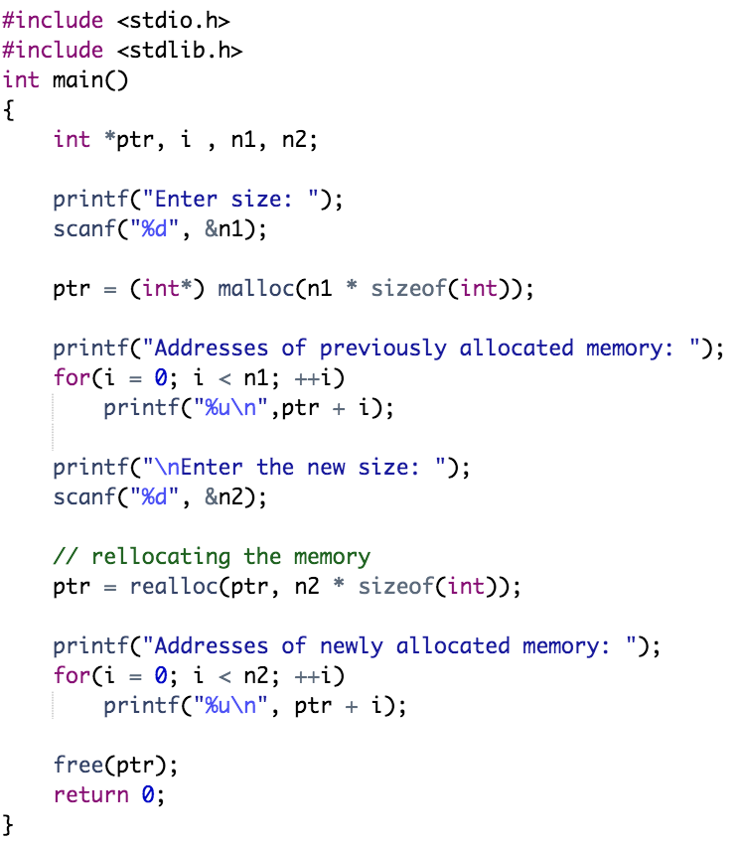
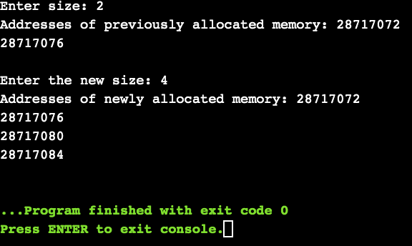
Example: Use of realloc()

Slide 16
Practical Exercises
Program 1:

Slide 17
Practical Exercises
Program 2:

Slide 18
Practical Exercises
Program 3:

